Slide 1
PRESAGE-Net (final solution)
Ching Chang

Slide 2
Main architecture
Attention mechanism with matrix factorization
New selling points
Self-supervised time series representation learning
Multivariate
Corruption (data augmentation)
Automated self-supervised learning (combine with matrix factorization)

Slide 3





























PRESAGE-Net (w/o anything)
$T$ decoder
$$T$$
Reshape
$$T$$
$$(T×k,)$$
$$(T,k)$$
$$×$$
$$\hat{D}$$
$$(T,n)$$
$$D$$
Reshape
$$D$$
Encoder
$$z$$
$F$ Decoder
$$F$$
Reshape
$$F$$
$$(T, n)$$
$$(T×n,)$$
$$(d,)$$
$$(k×n,)$$
$$(k,n)$$
$$×$$
$$C$$
w
$$\hat{q}$$
Reshape
$$(k,m)$$
$$(1,m)$$
$A$ Decoder
$$A$$
$$A$$
$$(n×m,)$$
$$(n,m)$$

Slide 4

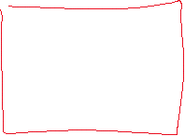


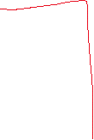



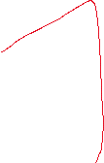
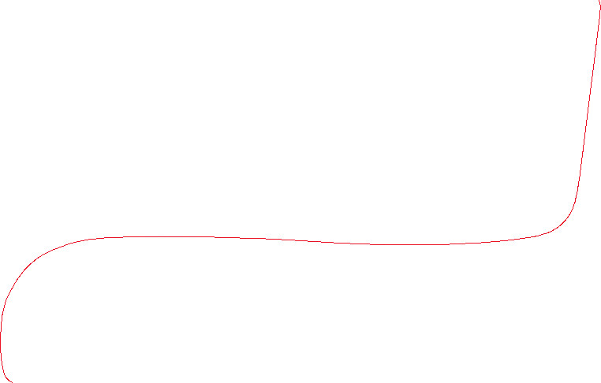



VIME
$T$ decoder
$$T$$
Reshape
$$T$$
$$(T×k,)$$
$$(T,k)$$
$$×$$
$$\hat{D}$$
$$(T,n)$$
$$D$$
Reshape
$$D$$
Encoder
$$z$$
$F$ Decoder
$$F$$
Reshape
$$F$$
$$(T, n)$$
$$(T×n,)$$
$$(d,)$$
$$(k×n,)$$
$$(k,n)$$
$$×$$
$$C$$
w
$$\hat{q}$$
Reshape
$$(k,m)$$
$$(1,m)$$
$A$ Decoder
$$A$$
$$A$$
$$(n×m,)$$
$$(n,m)$$

Slide 5



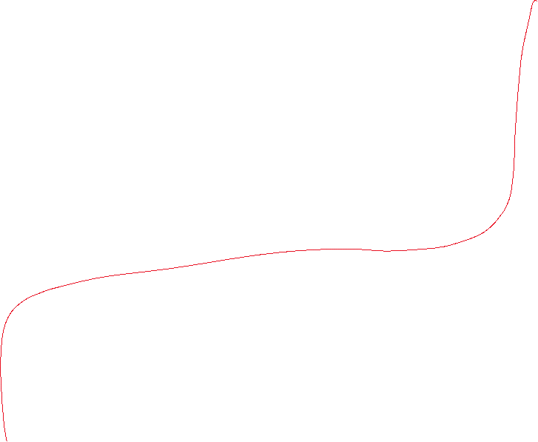
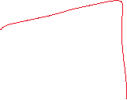





VIME
$T$ decoder
$$T$$
Reshape
$$T$$
$$(T×k,)$$
$$(T,k)$$
$$×$$
$$\hat{D}$$
$$(T,n)$$
$$D$$
Reshape
$$D$$
Encoder
$$z$$
$F$ Decoder
$$F$$
Reshape
$$F$$
$$(T, n)$$
$$(T×n,)$$
$$(d,)$$
$$(k×n,)$$
$$(k,n)$$
$$×$$
$$C$$
w
$$\hat{q}$$
Reshape
$$(k,m)$$
$$(1,m)$$
$A$ Decoder
$$A$$
$$A$$
$$(n×m,)$$
$$(n,m)$$

Slide 6

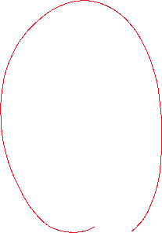
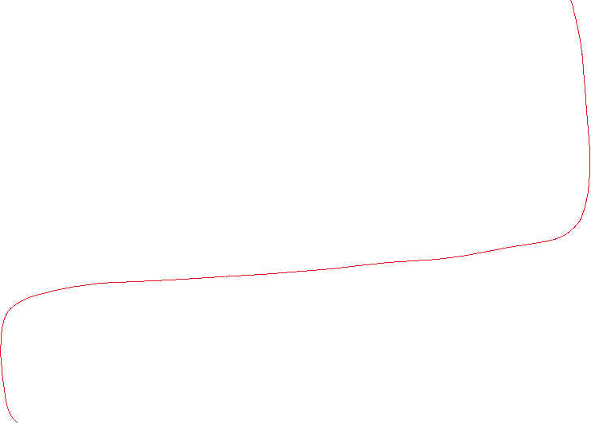


SCARF
$T$ decoder
$$T$$
Reshape
$$T$$
$$(T×k,)$$
$$(T,k)$$
$$×$$
$$\hat{D}$$
$$(T,n)$$
$$D$$
Reshape
$$D$$
Encoder
$$z$$
$F$ Decoder
$$F$$
Reshape
$$F$$
$$(T, n)$$
$$(T×n,)$$
$$(d,)$$
$$(k×n,)$$
$$(k,n)$$
$$×$$
$$C$$
w
$$\hat{q}$$
Reshape
$$(k,m)$$
$$(1,m)$$
$A$ Decoder
$$A$$
$$A$$
$$(n×m,)$$
$$(n,m)$$

Slide 7
















Why not combine self-prediction and contrastive learning?

Slide 8











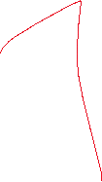











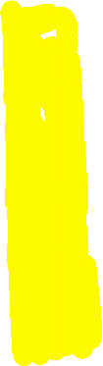




Why not combine self-prediction and contrastive learning?

Slide 9
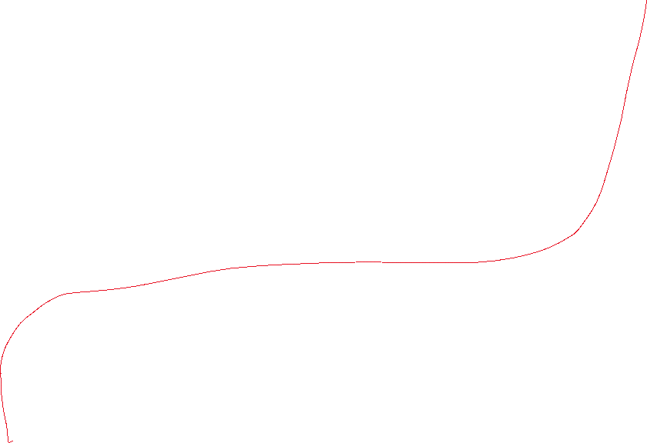
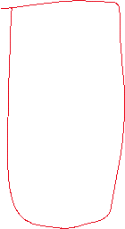

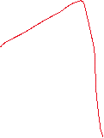












SubTab
$T$ decoder
$$T$$
Reshape
$$T$$
$$(T×k,)$$
$$(T,k)$$
$$×$$
$$\hat{D}$$
$$(T,n)$$
$$D$$
Reshape
$$D$$
Encoder
$$z$$
$F$ Decoder
$$F$$
Reshape
$$F$$
$$(T, n)$$
$$(T×n,)$$
$$(d,)$$
$$(k×n,)$$
$$(k,n)$$
$$×$$
$$C$$
w
$$\hat{q}$$
Reshape
$$(k,m)$$
$$(1,m)$$
$A$ Decoder
$$A$$
$$A$$
$$(n×m,)$$
$$(n,m)$$

Slide 10








ForeClass
$T$ decoder
$$T$$
Reshape
$$T$$
$$(T×k,)$$
$$(T,k)$$
$$×$$
$$\hat{D}$$
$$(T,n)$$
$$D$$
Reshape
$$D$$
Encoder
$$z$$
$F$ Decoder
$$F$$
Reshape
$$F$$
$$(T, n)$$
$$(T×n,)$$
$$(d,)$$
$$(k×n,)$$
$$(k,n)$$
$$×$$
$$C$$
w
$$\hat{q}$$
Reshape
$$(k,m)$$
$$(1,m)$$
$A$ Decoder
$$A$$
$$A$$
$$(n×m,)$$
$$(n,m)$$

Slide 11




ForeClass
$T$ decoder
$$T$$
Reshape
$$T$$
$$(T×k,)$$
$$(T,k)$$
$$×$$
$$\hat{D}$$
$$(T,n)$$
$$D$$
Reshape
$$D$$
Encoder
$$z$$
$F$ Decoder
$$F$$
Reshape
$$F$$
$$(T, n)$$
$$(T×n,)$$
$$(d,)$$
$$(k×n,)$$
$$(k,n)$$
$$×$$
$$C$$
w
$$\hat{q}$$
Reshape
$$(k,m)$$
$$(1,m)$$
$A$ Decoder
$$A$$
$$A$$
$$(n×m,)$$
$$(n,m)$$

